Slide 1
ReactOS is (not) Windows
Windows internals and why ReactOS couldn’t just use a Linux kernel

Slide 2
ReactOS is (not) Windows
ReactOS is Windows
  Runs Windows applications
  Runs Windows drivers
  Looks like Windows
ReactOS is not Windows
  ReactOS is a free, open source project
  ReactOS reuses open source code from other projects
  You can make “your own Windows”

Slide 3


Who am I?
Michele “KJK::Hyperion” C. from Milano
  Senior ReactOS developer (since 2001)
  hackbunny@reactos.org

Slide 4
WINDOWS ARCHITECTURE
What does Windows mean

Slide 5
ReactOS is Windows
ReactOS has the same identical architecture as Windows, for maximum compatibility
  Windows drivers require a Windows kernel
  Many applications (firewalls, antivirus, media players, PDA sync software, etc.) come with special drivers
Windows architecture is quite different from Linux and not as well known
Let’s start from the basics…

Slide 6
Operating system architecture
Abstraction of CPU time and context (processes, threads, signals, etc.)
Abstraction of memory (virtual memory, paging, stacks, heaps, etc.)
Separation between system and applications through CPU’s built-in memory protection (user mode vs kernel mode)
Separation between hardware and applications through CPU’s built-in I/O privilege mechanisms
Mechanisms to bypass OS protection features in a controlled, secure way (system calls, security subsystem, etc.)

Slide 7



Operating system architecture
Applications
User mode
Kernel
Kernel mode
User
Hardware

Slide 8
Linux architecture
Monolithic kernel. No kernel ABI
UNIX process management and security model
Native networking support
  Sockets, pipes
  select, poll, etc.
Filesystem abstraction (VFS)
UNIX API (libc) on top of a small UNIX-like system call and signals interface
Other APIs (audio, application setup, desktop environment integration, cryptography, etc.) are de facto standards from third parties
  The graphic subsystem (X server) is in a category of its own. The kernel has “backdoors” to let the X server talk directly to the hardware, to keep the complexity of video drivers outside of the sensitive environment of kernel mode

Slide 9
Linux architecture
Applications
X server
Application libraries
libc
System calls
Signals
Direct I/O
System Call Interface
User mode
Kernel mode
VFS
PM
MM
Network stack
Kernel
Arch
Device drivers
Virtual
Disk
CPU
MMU
Devices
Video card
Physical

Slide 10
Windows (NT) architecture
Monolithic kernel. Relatively stable kernel ABI
Kernel design is almost identical to DEC RSX-11 and VMS, with DOS, OS/2 and Windows 95 influences
  RSX-11, VMS and Windows NT were designed by the same engineer (Dave Cutler)
  Windows NT was initially developed as a new kernel for OS/2
No device abstraction in the kernel itself. Abstraction is provided by standard system drivers (class or port drivers)
No network support in the kernel itself. select/poll is not a system call, but an ioctl to the “socket filesystem”
  Sockets and pipes are provided by two special filesystems
  Further user-mode layer of abstraction sockets: Winsock used to be a third-party component (e.g. Trumpet Winsock)
Native graphics and windowing subsystems (running in kernel mode) with a standard API
Rich, high-level APIs of all sorts (cryptography, desktop environment, etc.)

Slide 11
Unique Windows architecture features
Chipset devices (timer, interrupt controller, power management, buses, firmware, etc.) are abstracted by a kernel component called Hardware Abstraction Layer (HAL)
  ACPI vs non-ACPI is just a different HAL
  The ReactOS port to the XBox was a regular x86 ReactOS with an XBox-specific HAL
No signals; standard exception model instead (“SEH”, shared with VMS, OS/2 and Tru64)
Reverse system calls (callbacks): windowing and graphics subsystem can call back into user mode
  The user-mode and the kernel-mode parts of the subsystem used to run in shared memory in their original implementation (Windows 95)
  Too unsafe for Windows NT; emulates a secure but compatible shared memory environment with some “tricks” (like callbacks)

Slide 12
Windows architecture
Services
Applications, application libraries
System libraries
kernel32
user32
gdi32
DirectX
ntdll
Executive
win32k
Device drivers
HAL
Kernel
Chipset devices
CPU, MMU
Devices

Slide 13
WINE AND REACTOS
ReactOS is (not) Wine

Slide 14
ReactOS is (not) Wine
“If ReactOS is just a kernel for Wine…
  … what do we need it for?”
  … why isn’t it finished yet?”
As always, things are more complicated than they appear…

Slide 15
Wine and ReactOS
ReactOS has a lot in common with Wine, and we can share a lot of code with them…
  Enough common goals:
    Installing Windows applications
    Running Windows applications
… but…
  Too many different goals
    Running on Linux vs running on hardware
    Whether to support Windows drivers

Slide 16
Wine on Linux
Windows applications can only be loaded by a Wine utility (the Wine loader)
Windows applications and DLLs are dynamically linked to Wine reimplementations of Windows system DLLs
  Most Wine DLLs are regular Windows DLLs compiled as Linux code
  Some are internally Linux libraries, depending on other Linux libraries. Linux libraries are transparent to Windows applications – they act as system calls in all respects
A service process (Wine Server) replaces the Windows kernel for the management of shared resources

Slide 17





Wine on Linux
Windows applications
Wine services
Wine loader
Wine server
Wine libraries
Linux libraries
X server
GNU libc
User mode
Kernel mode
Linux kernel

Slide 18

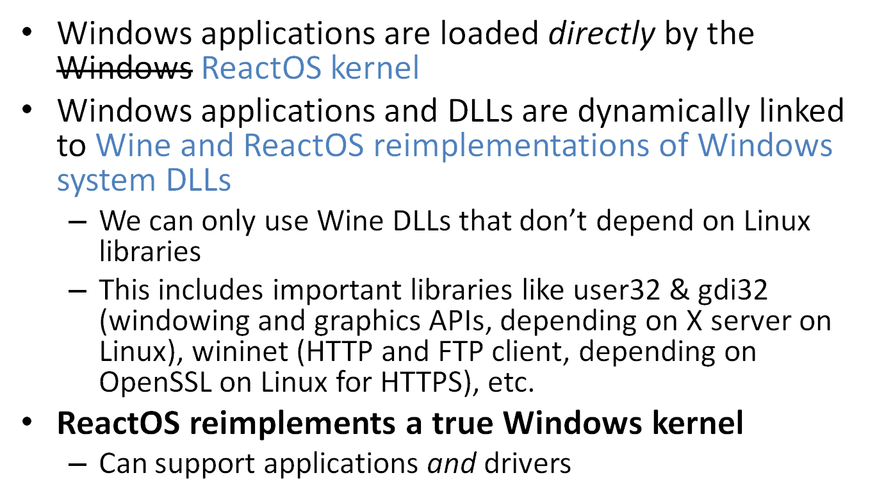

Slide 19
Wine on ReactOS
Services
Windows applications
System libraries
kernel32
user32
gdi32
DirectX
ntdll
User mode
Kernel mode
Executive
win32k
Windows drivers
HAL
Kernel

Slide 20
Wine and ReactOS: summary
Wine was designed to run Windows applications on Linux. Linux-specific dependencies are:
  … invisible to applications
  … an integral part of Wine design
ReactOS was designed to be Windows:
  Needs to take as much as possible from Wine
  Needs to reimplement what Wine implements in a Linux-dependant way
  Implementation cannot just be “functionally equivalent”: must be “binary-compatible”, because in Windows everything is an API
  Not a lot of code can be reused from other projects
ReactOS is complex and irreplaceable

Slide 21
REACTOS ARCHITECTURE
ReactOS is (not) Windows

Slide 22
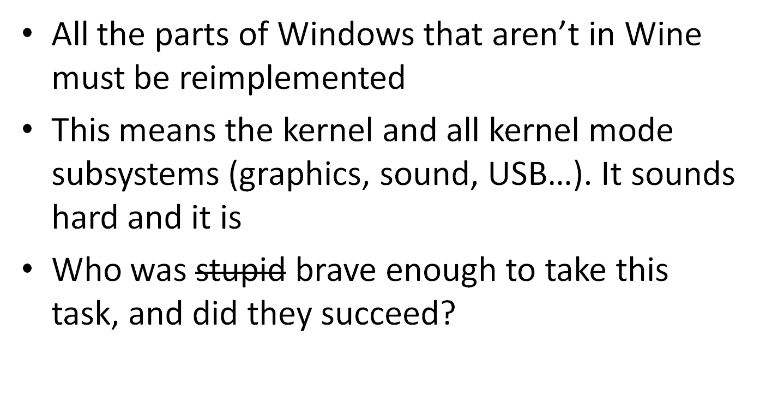
ReactOS is not Windows

Slide 23
The ReactOS crew
A truly “international” project
  Founded by Jason Filby from South Africa
  Most early developers and the first ReactOS foundation from the USA
  Today, a Russian foundation and project coordinator, most developers from Germany and the USA, and a community spanning the globe
No formal training
  Almost all developers learned Windows internals while working on ReactOS
  Sadly for the project (but happily for them), the best developers are “snagged” by Microsoft and other large companies
Very little information available to the public
  “Inside Microsoft Windows” is the reference on Windows design and internals
  … but it’s not enough information for ReactOS development

Slide 24
The ReactOS kernel
Many developers alternated developing the ReactOS kernel and subsystem, with mixed results
Good quality:
  Scheduler, HAL, process and thread manager (thanks Alex Ionescu!)
Fair quality:
  I/O subsystem, configuration manager (registry), security manager
    Security manager is good enough to support a prototype implementation of Mandatory Access Control (MAC) I did for my BS thesis
Poor quality:
  Memory manager, cache manager, filesystem support library: three tightly coupled components that have been our “white whale” since the beginning
Non-existing:
  Power management
Nevertheless, the ReactOS kernel is…

Slide 25
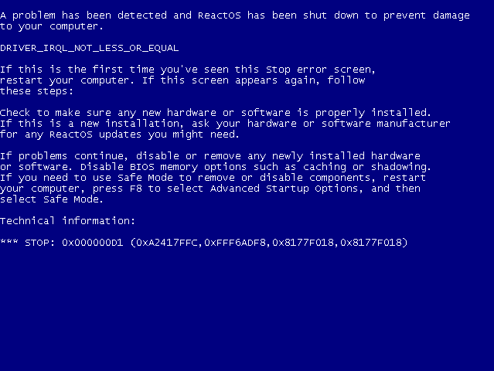
The ReactOS kernel
… compatible enough!

Slide 26
The windowing subsystem (USER)
Another long-time “white whale” sub-project
Many developers tried and failed
  Three separate rewrites, one still ongoing
The original implementation is a very good hack…
  Windowing subsystem comes all the way back from Windows 1.0
  The port to Windows NT introduced memory protection, but the API implies shared memory
  Several dedicated hacks to simulate shared memory safely – user32.dll is not just a library, but the user-mode half of the windowing system
… but a really poor design
  Impossible to give an good, high-level description of the architecture
  Nobody documents all of it, neither officially nor unofficially

Slide 27
The graphics subsystem (GDI)
Tightly coupled with the windowing subsystem
Much simpler, better design
  gdi32.dll is a partial user-mode reimplementation of the subsystem, to run user-mode display drivers (i.e. printer drivers)
  Drawing algorithms are well isolated in a simple API
    All our font drawing code comes from FreeType (a third-party, open source project)
Efforts concentrate on the more complex (and visible) windowing subsystem, however
DirectX graphics is a whole another matter entirely…

Slide 28
Networking
The networking stack in Windows is outside the kernel
… but the stack is split into independent layers, with many documented APIs between them:
  Winsock
  TDI
  NDIS
Each part has to be implemented in a Windows-compatible way
… but many parts are complex enough inside to make it possible to wrap a large third-party implementation in a Windows-compatible “shell”
  Our TCP/IP driver is almost 100% FreeBSD code
“Good enough” quality

Slide 29
REACTOS PRESENT AND FUTURE
What are we working on, what we will work on

Slide 30
Driver support
Stand-alone drivers run well enough
  Video drivers
Complex abstraction layers need more work
  USB
  Sound
  Network card drivers (except PCI Ethernet cards)
Filesystem drivers (including network filesystems) require a lot of work on the kernel “big three” (cache manager, memory manager, filesystem support)

Slide 31
USB
We used to use a port of the Linux Cromwell stack, but it “bit-rotted”
  Used in the XBox port (XBox only supports USB input)
We currently use a USB compatibility layer for Windows NT 4
  “Good enough” for light use (USB keyboards, mice, etc.)
  Windows NT 4 lacked kernel features to properly support USB, so the compatibility layer is very different from “real” USB support
Our I/O subsystem is not ready yet for full, “real” USB support

Slide 32
Audio subsystem
It works!
  ReactOS can play audio
  The audio subsystem prototype successfully played several hours of streamed MP3 audio through Winamp
… but it’s very incomplete
Hard to find people with experience in Windows audio

Slide 33
Kernel subsystems
Cache manager rewrite is in progress
The ARM port resulted in a large cleanup of the memory manager
Overall quality improvements

Slide 34
Development tools
We don’t support the Windows kernel debugger… yet
We only support compilation with gcc, which doesn’t play nice with Windows tools
  We contribute to the development of the Windows port of gcc (MinGW) because we are probably its largest user (and we find a lot of bugs in it!)
  MinGW was never expected to compile a kernel!
  I’m working on a build environment and source code clean-up to support compilation with Microsoft Visual C++
    More accessible to new developers
    Better integration with Windows development tools

Slide 35
CLOSING REMARKS
What did we learn today?

Slide 36
Summary
Windows is a pretty normal operating system, after all!
ReactOS…
  … is (not) Windows: it’s a 100% open source reimplementation of Windows
  … is not Linux: it runs Windows drivers
  … is not Wine: it uses Wine, but Wine is only part of it
ReactOS is complex and unique
ReactOS is a lot of work

Slide 37

Any questions?
Brought to you by

